Slide 1
Manchester
Raspberry Jam 24
December 2014

Slide 2
Last Time...

Slide 3
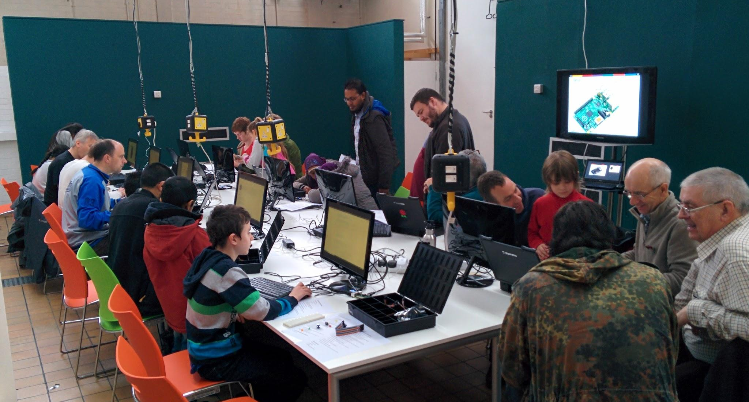
Manchester Raspberry Jam 23

Slide 4
In The News...

Slide 5

Linux Voice Issue 1 released under CC BY-SA
http://www.linuxvoice.com/download-linux-voice-issue-1-with-audio/

Slide 6
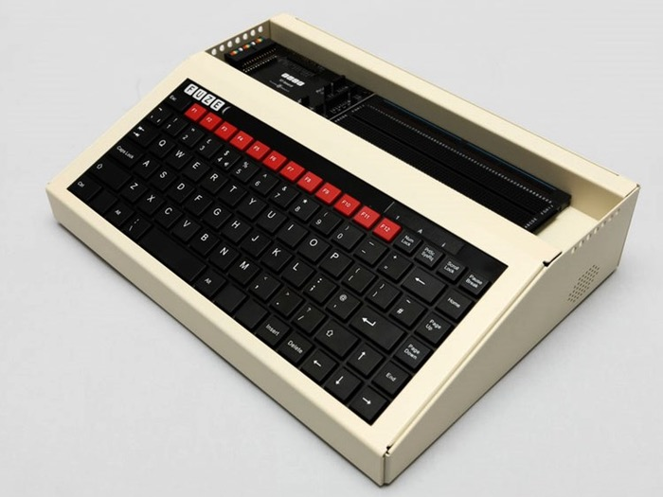
FUZE T2-SE BBC Model B style case
https://www.geeky-gadgets.com/raspberry-pi-fuze-retro-bbc-model-b-special-edition-unveiled-01-12-2014/

Slide 7
Projects...

Slide 8
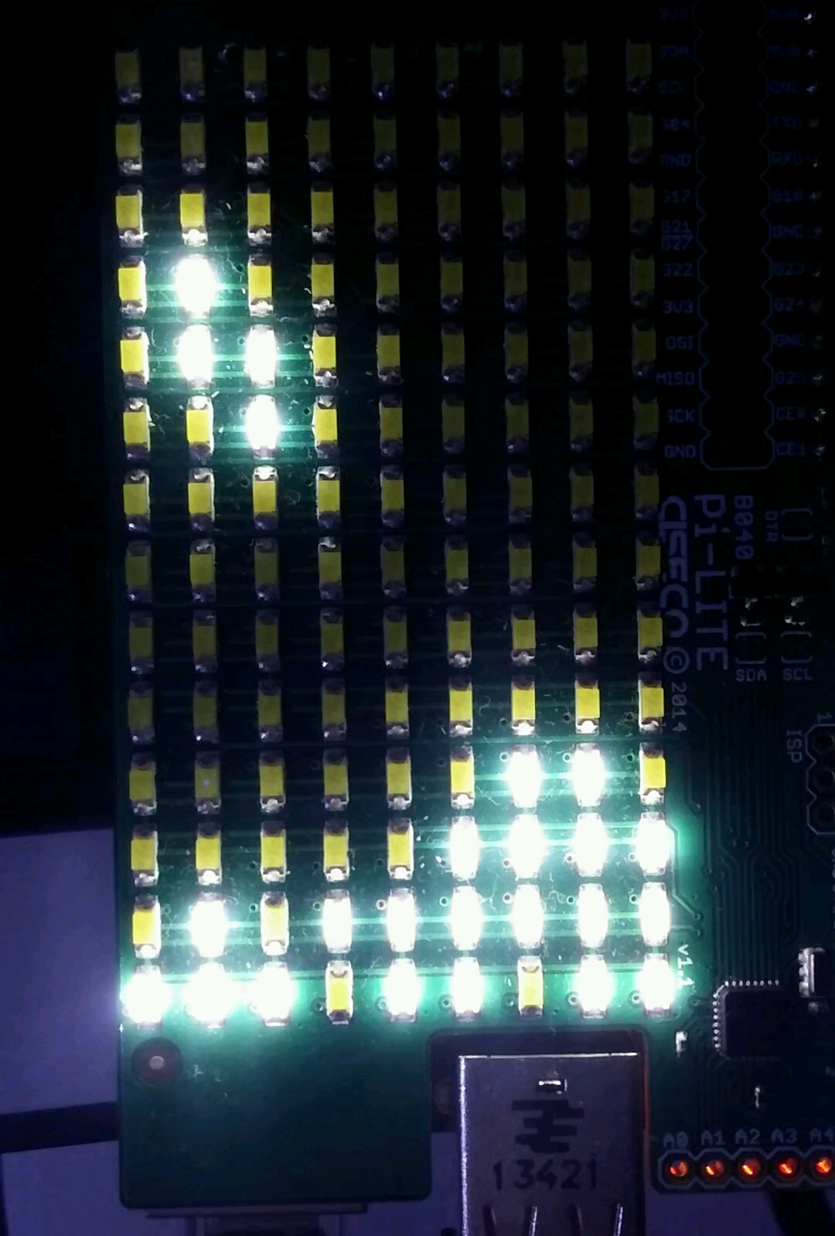
PiLite Tetris
http://piecesofpi.co.uk/tetris-on-leds/

Slide 9
Coming soon...

Slide 10
Next Month...
Manchester Raspberry Jam 25
Saturday 17th December
mcrraspjam25.eventbrite.com

Slide 11
For today...

Slide 12
Today:
Pizza at 1pm
WiFi:
SSID MMU-Visitor
Pass. University

Slide 13
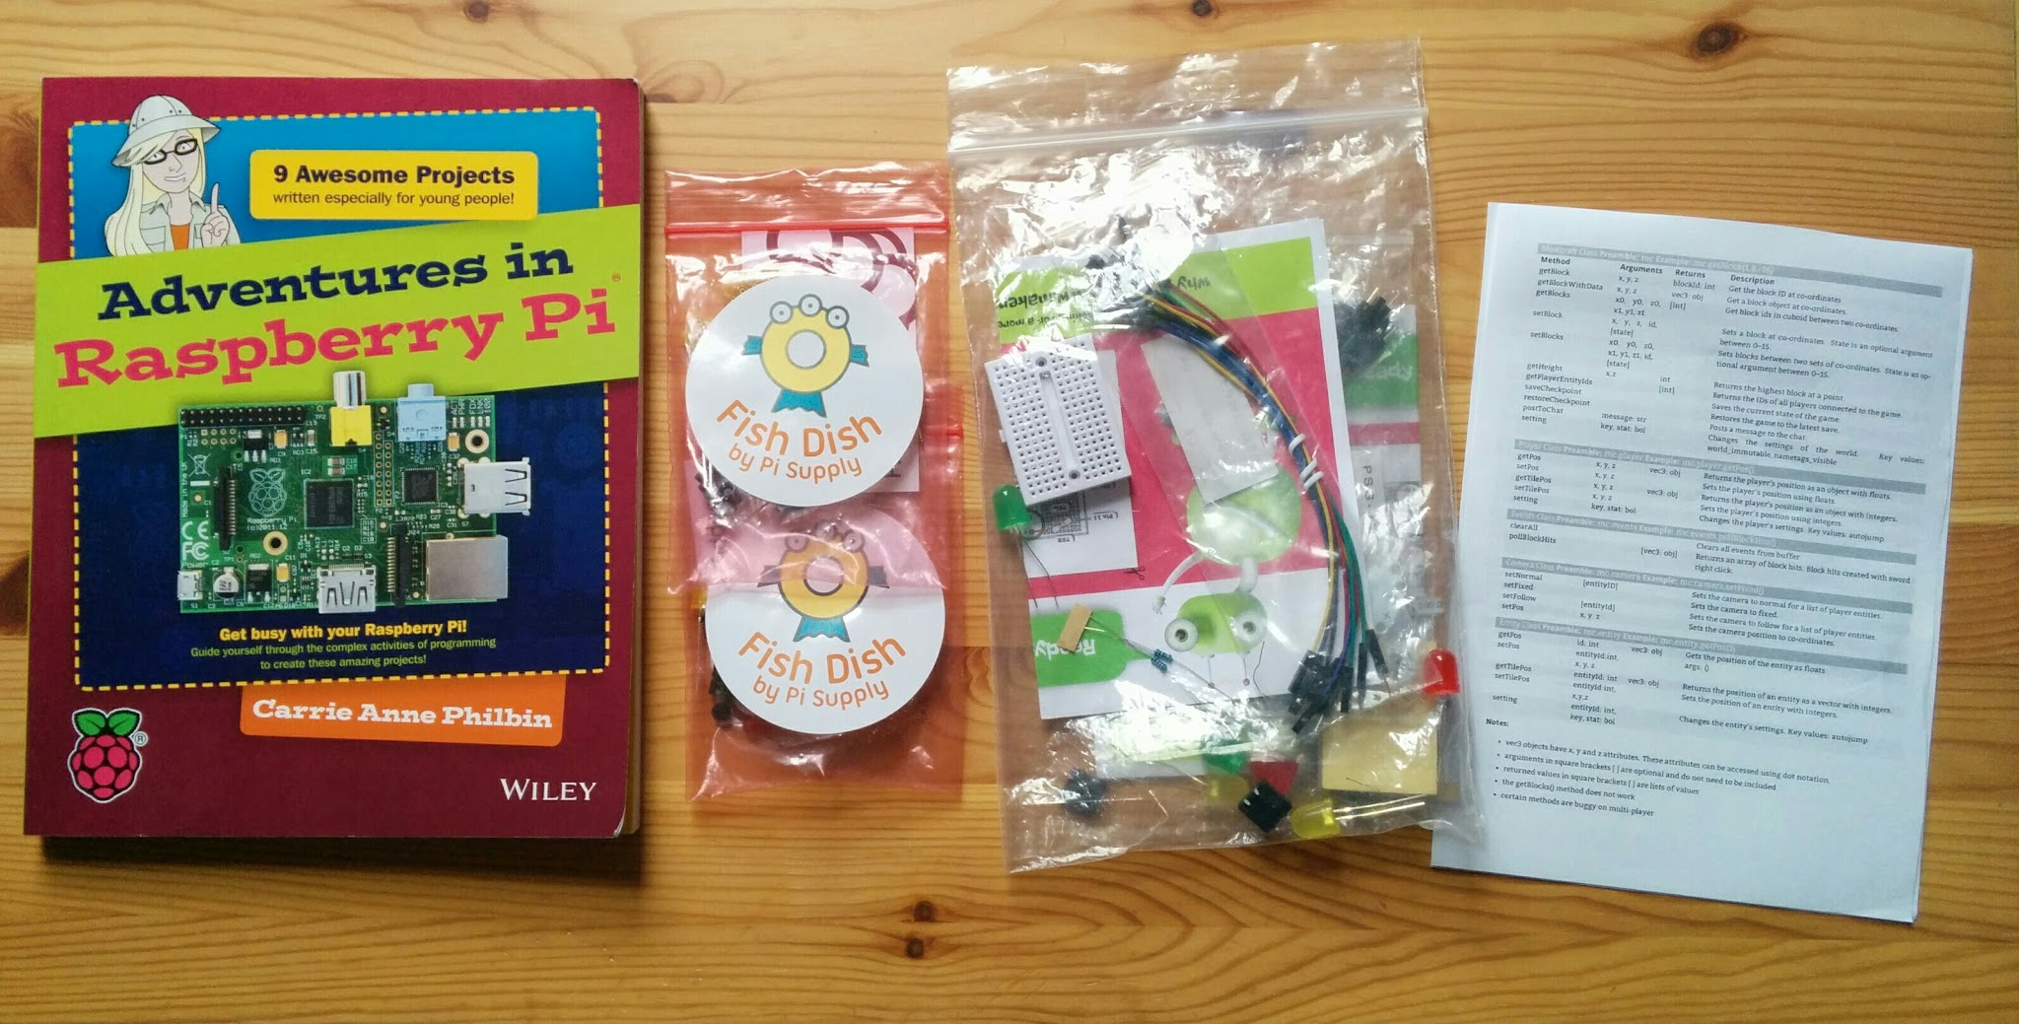
Stuck for ideas?
http://www.raspberrypi.org/introducing-raspberry-pi-model-b-plus/

Slide 14
Thanks to this month’s sponsors:
Sheela Dutton
Kevin Hainsworth
Paul Pearson
Rosemary Williams

Slide 15
Finally...
Tweet your photos and creations:
#McrRaspJam
Download the slides:
http://bit.ly/McrRaspJam24

